Slide 1


Slide 2
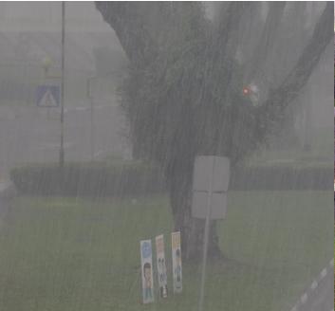
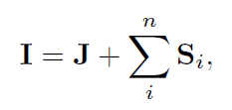

Background
In heavy rain, streaks are strongly visible, dense rain accumulation or rain veiling effect significantly washes out the image, further scenes are relatively more blurry
T: transmission map
A: the global atmospheric light of the scene
S: rain layer

Slide 3


Architecture

Slide 4
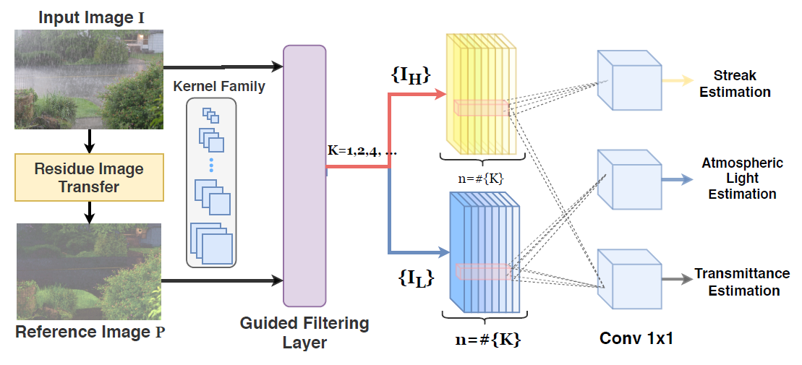

Colored-residue image guided decomposition module

Slide 5
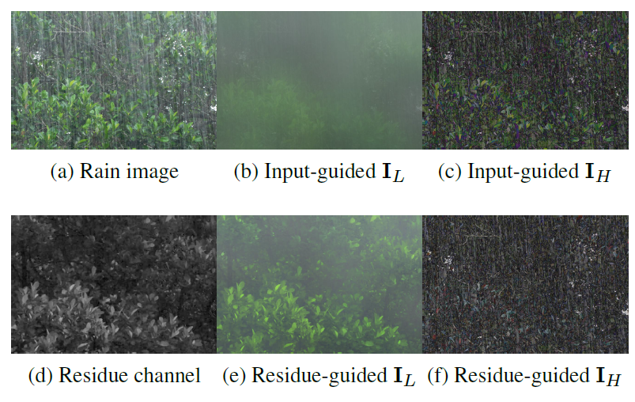

Slide 6
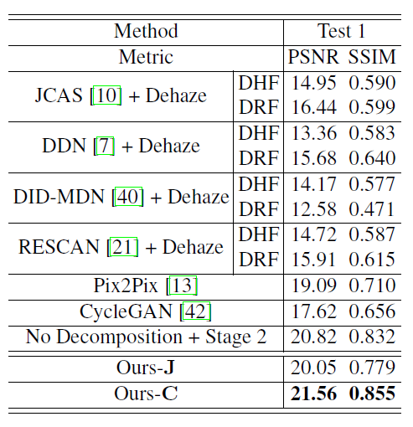
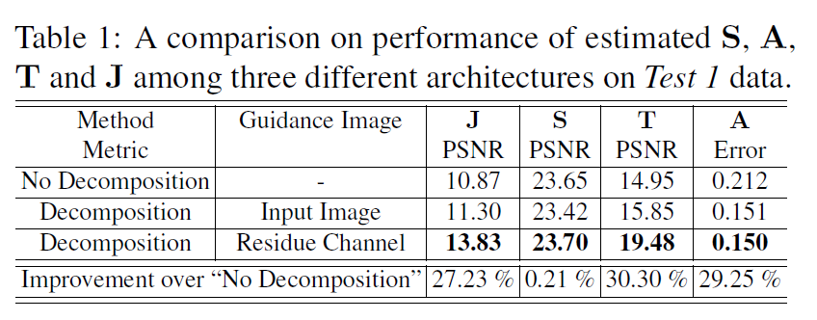
Experiment

Slide 7
